Slide 1
File Permissions

Slide 2
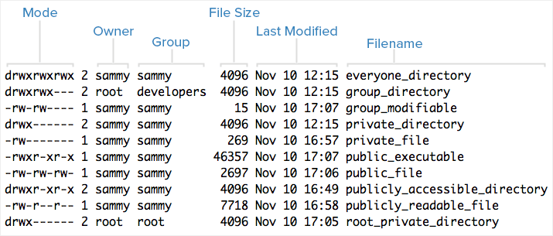
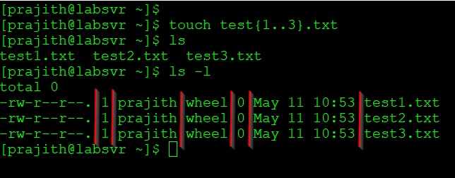
Understanding ls long listing (ls –l)
-rw-r--r- permissions
1 : number of linked hard-links
sammy: owner of the file
wheel: which group this file belongs to
0: size
May 11 10:53 : modification/creation date and time
test1: file/directory name

Slide 3
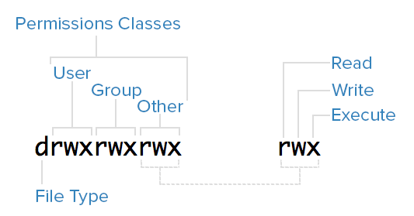
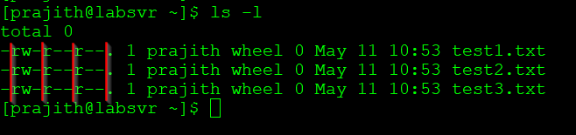
File Permissions
Read (r): The read permission allows the user to open the file and read its contents.
Write (w): The write permission allows the user to modify or change the contents of the file.
Execute (x): File execute permission
l,d,c in the first field stands for link, directory and character file respectively

Slide 4
File Permissions
-rw-------:
A file that is only accessible by its owner
-rwxr-xr-x:
A file that is executable by every user on the system. A “world-executable” file
-rw-rw-rw-:
A file that is open to modification by every user on the system. A “world-writable” file
drwxr-xr-x:
A directory that every user on the system can read and access
drwxrwx---:
A directory that is modifiable (including its contents) by its owner and group
drwxr-x---:
A directory that is accessible by its group

Slide 5
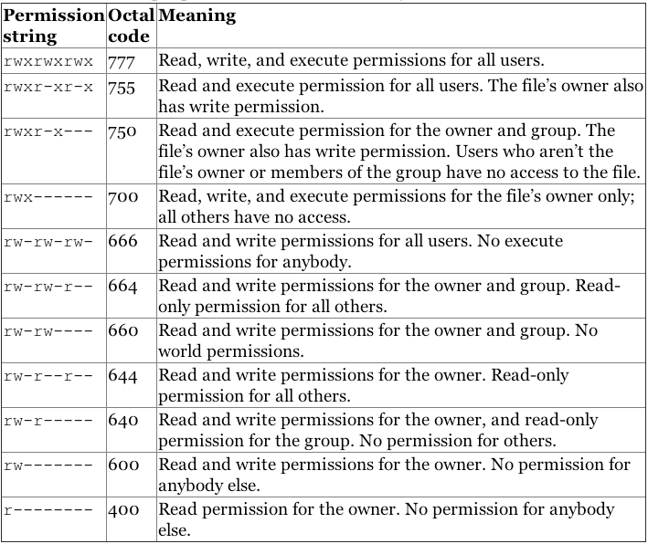
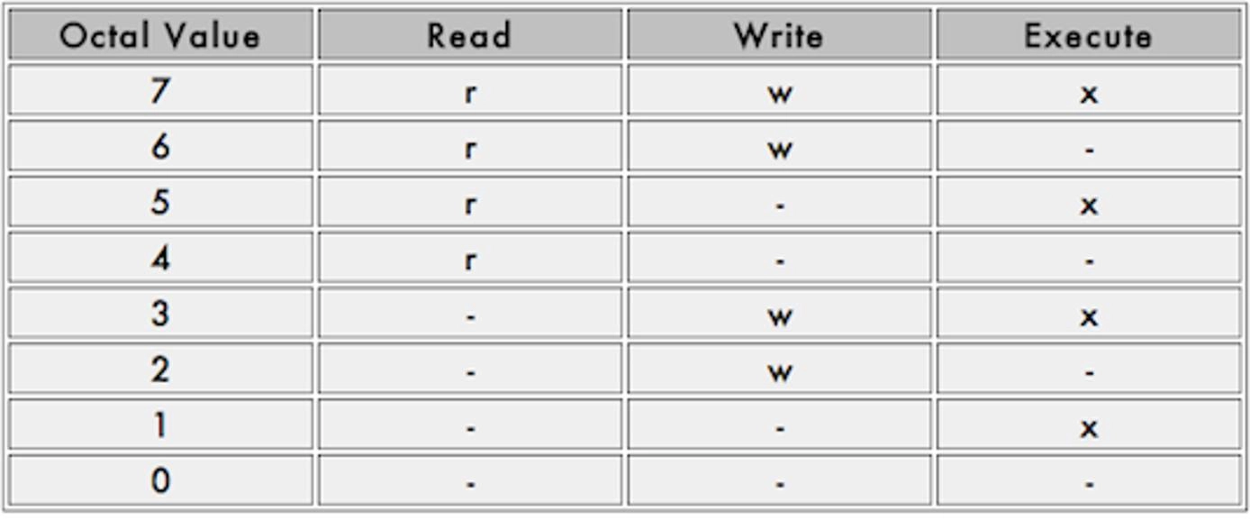
File Permissions
File permission are represented in terms of octal value

Slide 6
Additional Permissions +t mode (sticky bit) +s mode (setuid bit)
Sticky bit or +t mode:
When set only the owner (or root) can delete or rename files within that directory, regardless of which users have write access to the directory by way of group membership or ownership. (not applicable for file)
Example:
chmod +t /home/sam/testdir/
Setuid bit or +s mode:
When set on files allows users with permissions to execute a given file the ability to run that file with the permissions of file owner
Example:
chmod g+s /home/sam/testdir1
Chmod u+s /home/sam/testdir2

Slide 7
Changing file Ownership - chown
By default, all files are “owned” by the user who creates them and by that user’s default group
To change the ownership use chown command
Example:
chown user1:group1 /testdir/testfile1
chown –R user1:group1 /testdir/

